Slide 1

Lab #10: Deep Learning: Image Classification Study Report
Katherine Banis
kbb5551@psu.edu
CMPSC 497-001
12/3/2024

Slide 2
Table of Contents
3. Objective
4. Background and context
5. Dataset
6. Procedure
7. Results
9. Training Progress Plot
10. Confusion Matrix
11. Conclusion
12. Appendix (MATLAB Code)
13. References

Slide 3
Objective
The objective of this project was to train a deep learning model using AlexNet to classify images of wine bottle defects and determine the impact of varying the number of training epochs.

Slide 4
Background and Context
Project Motivation
Defect detection in manufacturing processes is critical to ensuring product quality. Automating this process using deep learning models reduces human error and enhances efficiency.
Potential Applications
Quality control in bottling industries.
Detection of visual defects in products.
Integration into real-time video inspection systems.

Slide 5
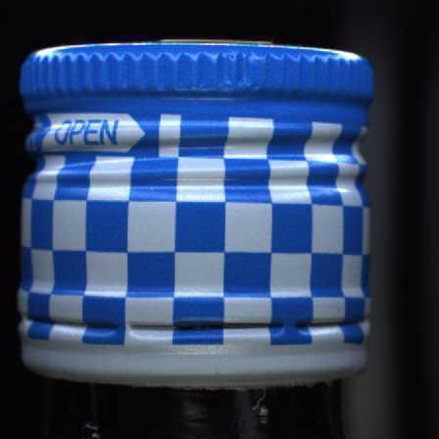
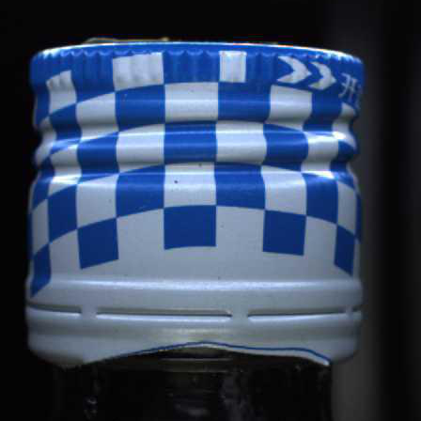
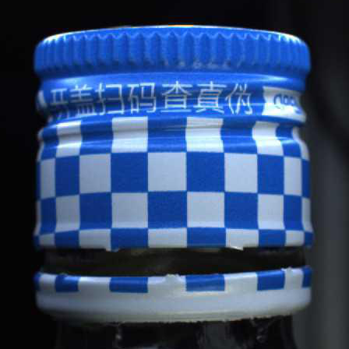
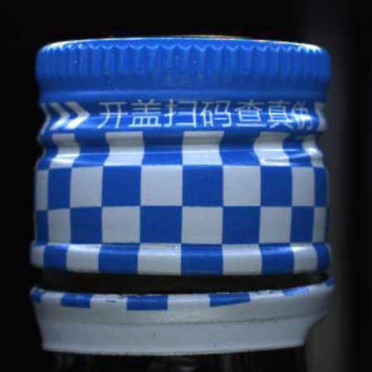
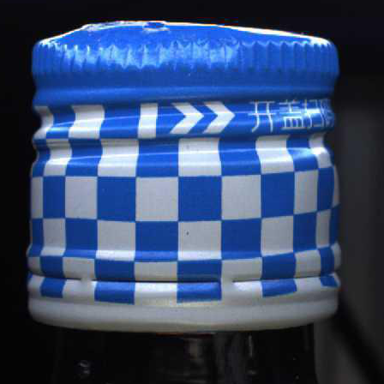
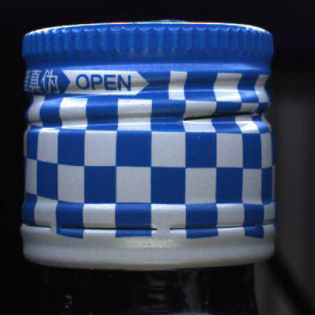
Dataset
The dataset consists of images categorized into six classes: good, bad_edge, bad_stitch, combined, deformed, and scratch.
Good | Bad_edge | Bad_stitch | Combined | Deformed | Scratch

Slide 6
Procedure
Load dataset from specified folder.
Preprocess images by resizing them to 227x227 for AlexNet compatibility.
Train AlexNet on good class images with modification for single-class training.
Test the trained network on images from all six classes.
Evaluate the performance using:
Test accuracy
Confusion Matrix
Conduct parametric study by varying the number of epochs (5, 10, and 20).
Analyze the results for optimal epoch selection and real-world generalization.

Slide 7
Results
Test with Unmodified AlexNet
Initial testing with unmodified AlexNet revealed a mismatch the network’s final layer and the dataset’s sic classes. The network was modified by adjusting the fully connected layer to output six categories and updating the classification layer.

Slide 8
Results
Parametric Study
Training was conducted for 5, 10, and 20 epochs with the following parameters:
Minibatch size: 16
Learning Rate: 0.001
Number of Iterations: 640
Epochs | Validation Accuracy (%) | Training Time (min)
5 | 87.64 | 9.6
10 | 88.42 | 21.2
20 | 89.19 | 38.1

Slide 9
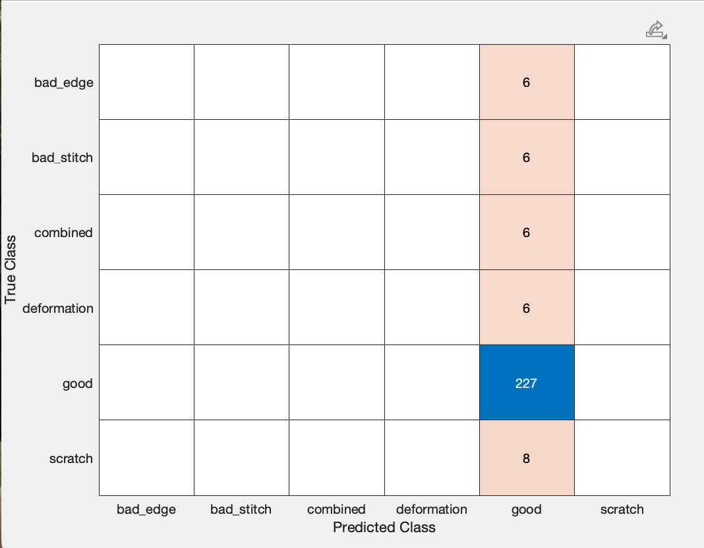
Results
Confusion Matrix – 5 epochs
Most samples in defect classes (bad_edge, combined, deformation, scratch) were misclassified as good.
Bad_stitch: 4 correctly classified samples
Validation accuracy: 87.64%

Slide 10
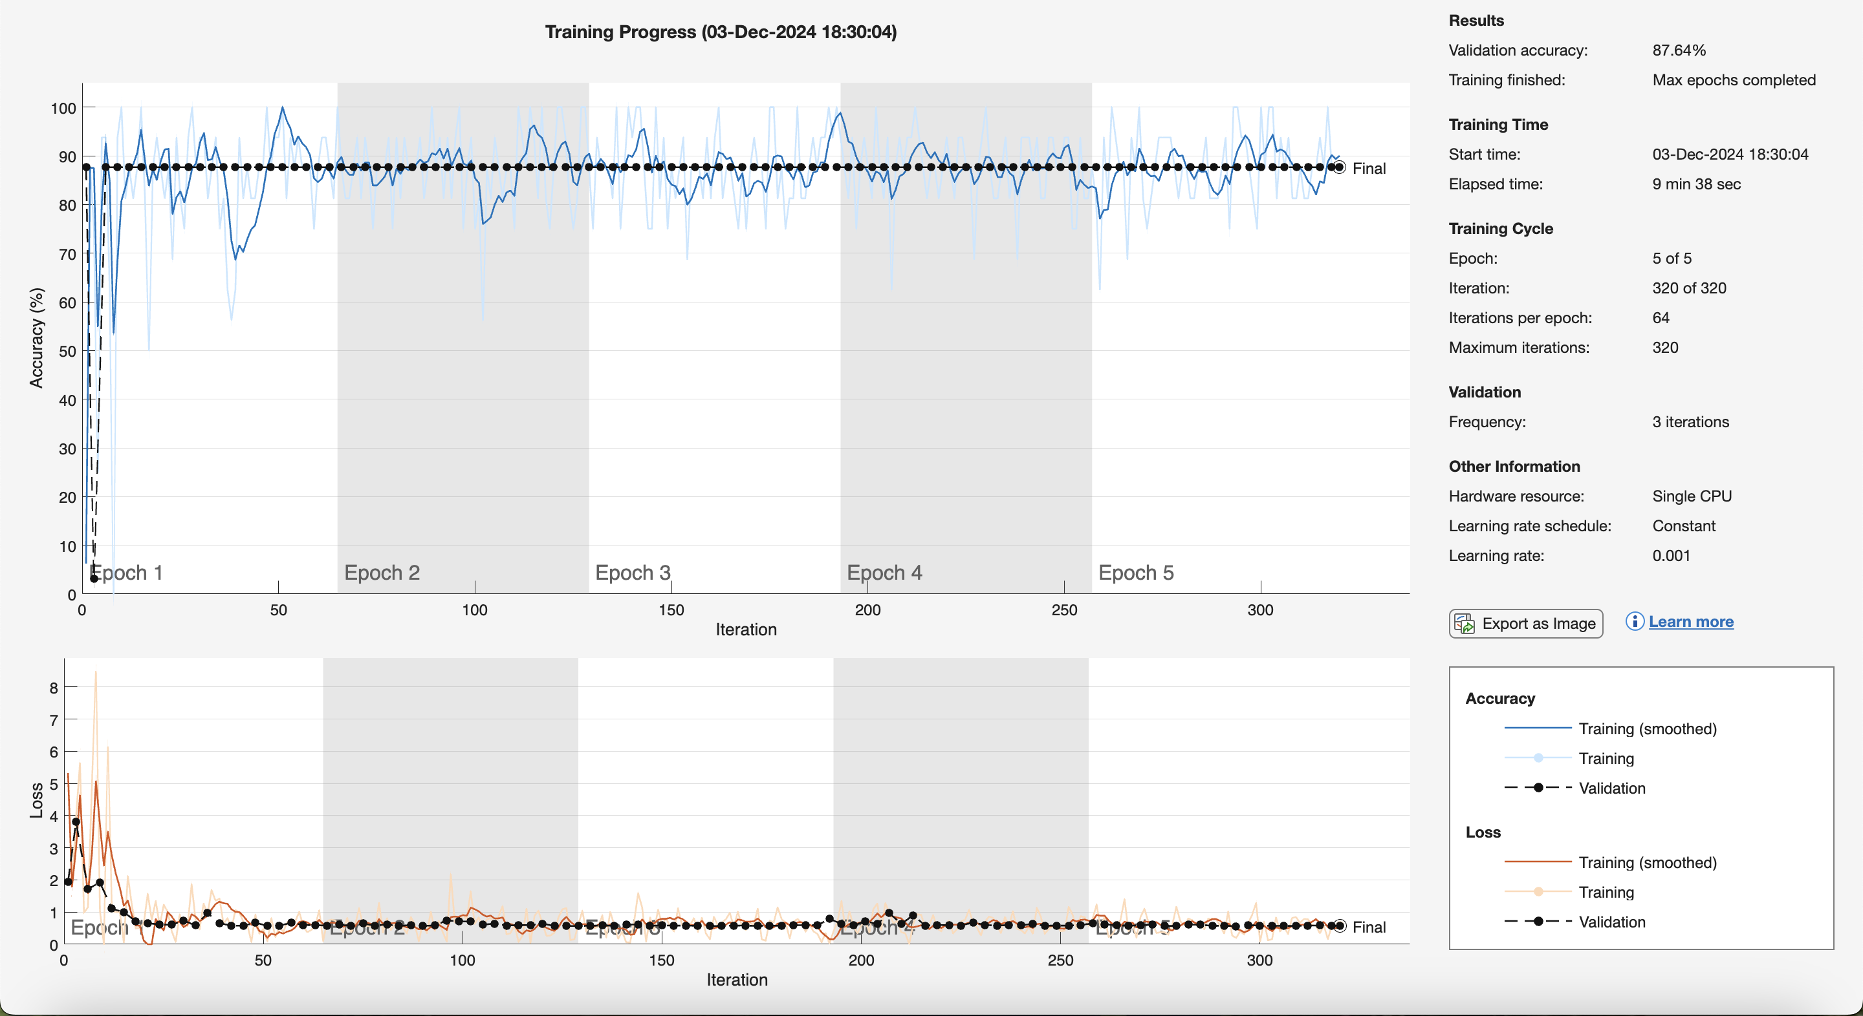

Slide 11
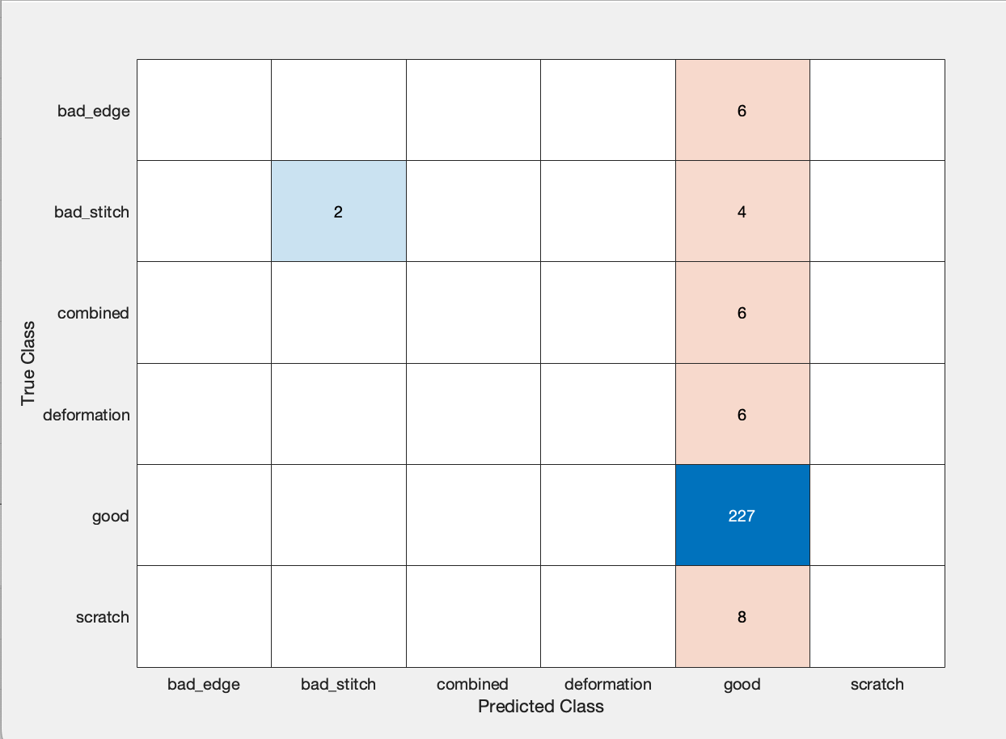
Results
Confusion Matrix – 10 epochs
Performance on defect classes improved slightly, with 3-4 correct classifications in defect categories.
Validation accuracy: 88.42%

Slide 12
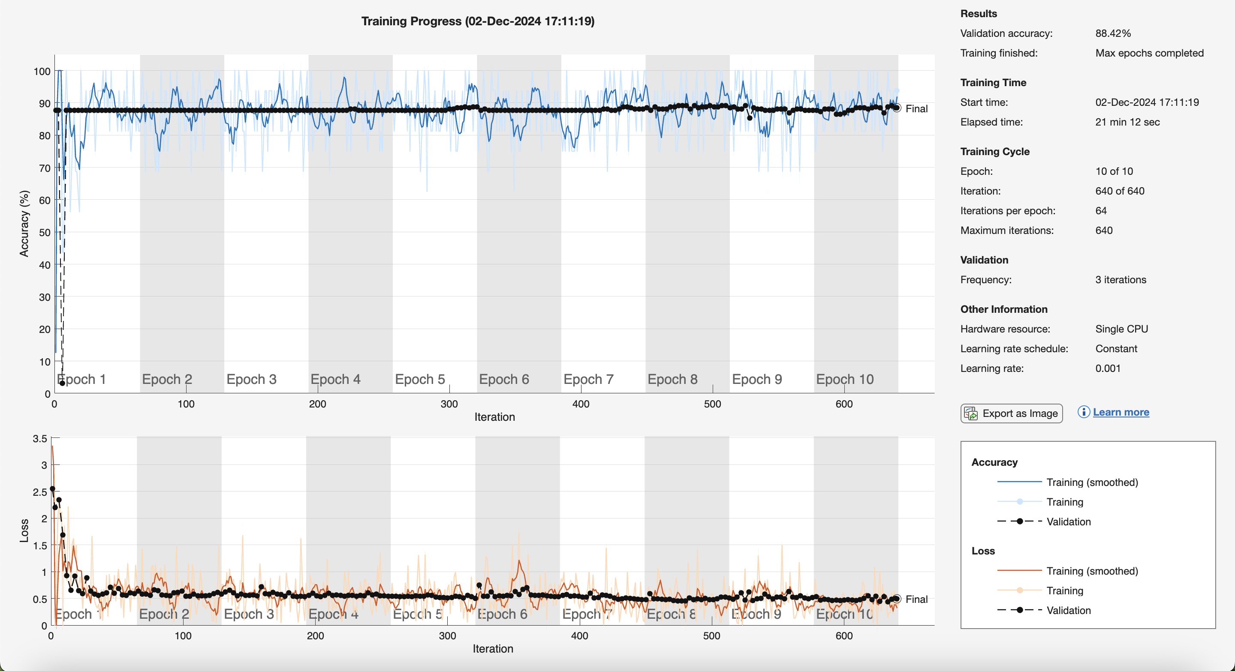

Slide 13
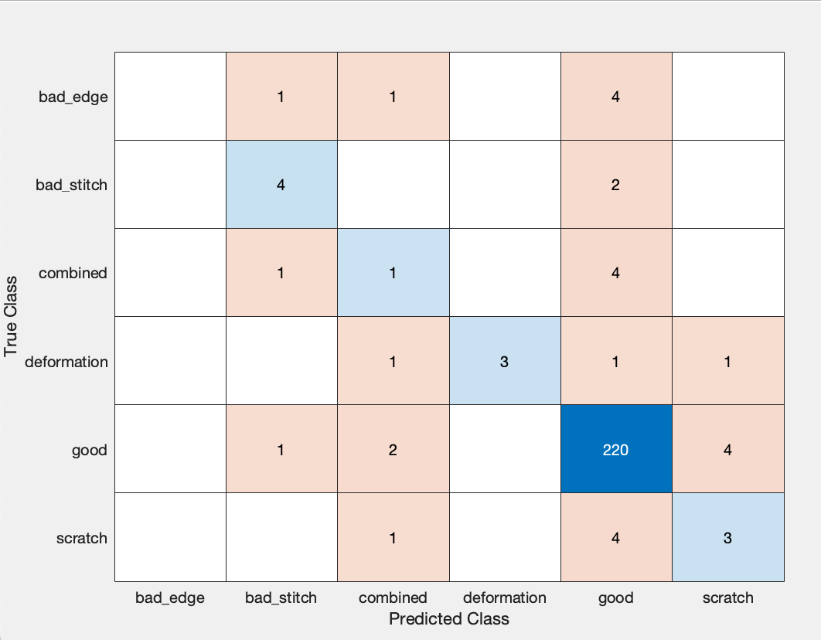
Results
Confusion Matrix – 20 epochs
Bad_edge and bad_stitch classifications improved slightly.
Overall accuracy plateaued, suggesting diminishing returns after 10 epochs.
Validation accuracy: 89.19%

Slide 14
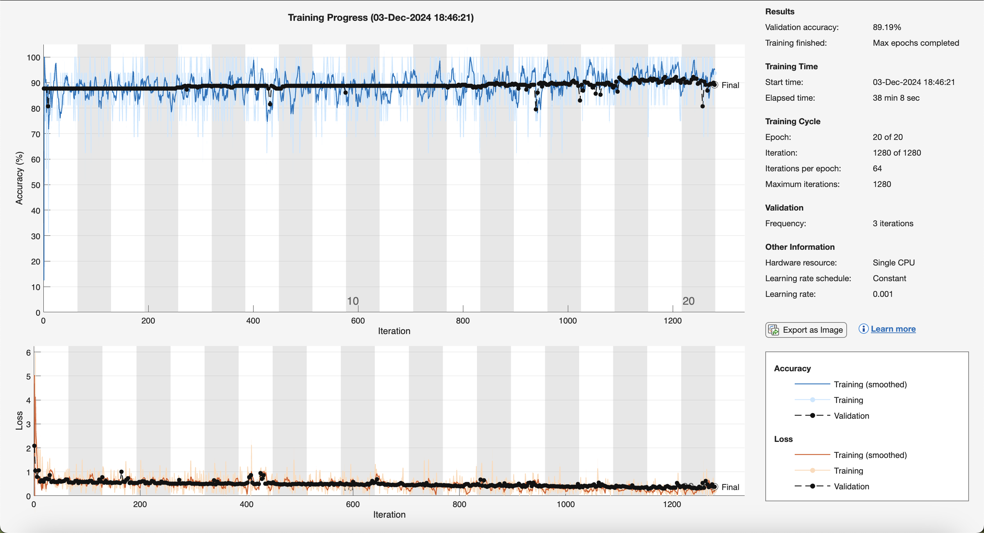

Slide 15
Conclusion
Generalization
The model effectively classified the good class but struggled to classify the defective classes. This indicates a need for a better feature extraction and dataset balancing.
Impact of Training Epochs
Validation accuracy improved slightly between 5 and 10 epochs, but plateaued by 20 epochs.
Misclassifications for defect classes persisted despite an increase in epochs.
Failure Cases
Scratch and Combined defects were frequently misclassified as good.
Bad_stitch showed improved accuracy with increased epochs but remained challenging.
Future Work
Investigate feature extraction techniques to improve classification of subtle defects.

Slide 16
Code
% Load training data training_data = "/Users/katherinebanis/Desktop/wine/test"; allImages = imageDatastore(training_data, 'IncludeSubfolders', true, 'LabelSource', 'foldernames’);
% Define a preprocessing function for resizing images to match AlexNet input readFunction = @(x) imresize(imread(x), [227 227]); allImages.ReadFcn = readFunction;
% Split training and test images [trainingImages, testImages] = splitEachLabel(allImages, 0.8, 'randomize’);
% Load AlexNet alex = alexnet; layers = alex.Layers;
% Modify the network to match the number of classes numClasses = numel(categories(trainingImages.Labels)); layers(23) = fullyConnectedLayer(numClasses, 'Name', 'fc8’); layers(25) = classificationLayer('Name', 'output’);
% Set training options options = trainingOptions('sgdm', ... 'MiniBatchSize', 16, ... 'MaxEpochs', 10, ... 'InitialLearnRate', 0.001, ... 'Shuffle', 'every-epoch', ... 'ValidationData', testImages, ... 'ValidationFrequency', 3, ... 'Verbose', false, ... 'Plots', 'training-progress’);
% Train the modified AlexNet wine_net = trainNetwork(trainingImages, layers, options);
% Evaluate the network with test images predictedLabels = classify(wine_net, testImages); accuracy = mean(predictedLabels == testImages.Labels);
% Display results disp("Test Accuracy:"); disp(accuracy);
% Confusion chart confusionchart(testImages.Labels, predictedLabels);

Slide 17
References
AI and Deep Learning Lecture #4 by Robert Avanzato, Penn State Abington
MATLAB Deep Learning Toolbox Documentation
Dataset: https://paperswithcode.com/paper/learning-deep-feature-correspondence-for#code

